Slide 1
ENGINEERING MANAGEMENT CASE STUDY
Phase 1: Switchback Rollout Plan & Execution Strategy
A practical manager's plan: Capacity math, sprint milestones, team leadership, stakeholder alignment, and zero-trust quality guardrails.
Role
Scope
Target Net Hours
Engineering Manager (Player-Coach)
4 Sprints (8 Weeks) | 5 FTE Team
1,024 Feature Hours

Slide 2
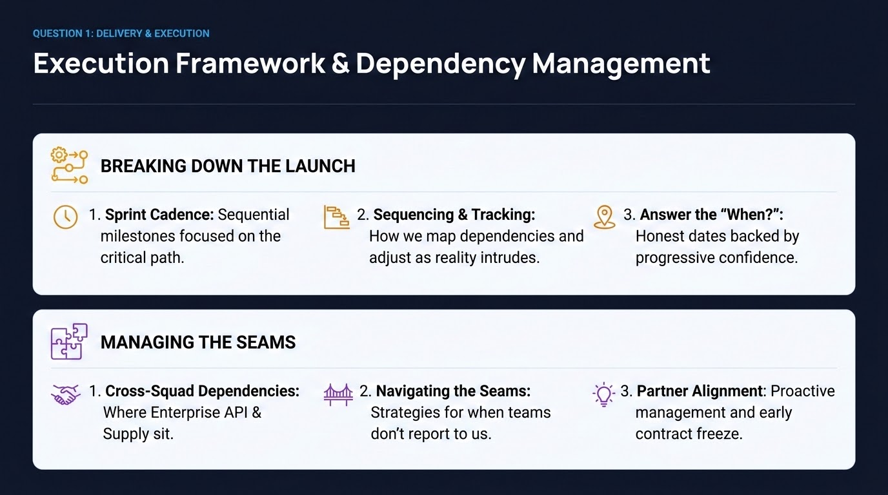

Slide 3
QUESTION 1: DELIVERY & EXECUTION
Capacity Planning: 1,024 Available Feature Hours Across 4 Sprints
Baseline Gross Capacity
Standard Overhead (80%)
Net Available (Carryover)
1,600
1,280
1,024
Gross Person-Hours Across 4 Sprints
Net Working Capacity Hours
Net Available Hours for New Features
•
•
Team Roster: 4 Engineers + 1 EM (5 FTEs).
Overhead Factor: 80% standard capacity limitation applied.
•
Buffer Allocation: 20% capacity demand reserved for carryover & tech debt.
•
Timeline: 4 Sprints = 8 Weeks = 40 Days.
•
Gross Math: 5 FTEs × 40 Days × 8 Hours/Day = 1,600 Gross Hours.
•
Accounts for: Ceremonies, meetings, context switches, and administrative duties.
•
Final Feature Hours: 1,280 Net Hours × 0.80 = 1,024 Hours.
•
Formula: 1,600 Gross Hours × 0.80 = 1,280 Net Hours.
•
Cadence Rate: 256 hours/sprint across team.

Slide 4
QUESTION 1: DELIVERY & EXECUTION
Execution Plan: Sprints 1 & 2 Milestone Roadmap
Sprint 1: Foundation & Contracts
Sprint 2: Core Engineering & Telemetry
WEEKS 1–2 | FOCUS: INFRASTRUCTURE & ALIGNMENT
WEEKS 3–4 | FOCUS: LOAD-BEARING SLICES & CONTRACT FREEZE
•
•
Co-Create Execution Plan: Align with Priya & secure Director sign-off.
Component Engineering: Unit test & review SSO handoff, degraded-mode fallback, and tenant-isolation guardrails.
•
Cross-Squad Contracts: Provide API requirements & due dates to Enterprise API and Supply squads. These will not be surprises as both groups will be brought into alignment prior to kickoff.
•
Contract Freeze: Formal cross-squad API schema freeze with external teams.
•
Internal SIT: Integration testing across internal Switchback boundaries and local stubs.
•
AWS Infrastructure: Provision Staging/Canary IaC, VPC, PrivateLink endpoints, and Secrets Manager.
•
Telemetry & Audit: Instrument New Relic custom attributes () & PII masking audit.
tenant_id
•
Architecture Sign-Off: Secure approval on zero-trust identity and tenant-isolation boundaries.

Slide 5
QUESTION 1: DELIVERY & EXECUTION
Execution Plan: Sprints 3 & 4 Integration & Rollout
Sprint 3: Integration, Resilience & Rootly
Sprint 4: Phased Canary Rollout & GA
WEEKS 5–6 | FOCUS: LIVE ENDPOINTS & INCIDENT TRIAGE
WEEKS 7–8 | FOCUS: GO/NO-GO & PROGRESSIVE CUTOVER
•
Live Cross-Squad SIT: End-to-end integration testing with Enterprise API and Supply live endpoints.
•
Go/No-Go Gate: Conduct CAB review & formal Go/No-Go meeting with EM, Priya, Marcus, and leads.
•
Stress & Chaos Testing: ECS auto-scaling, DB connection pool stress, and fault injection validation.
•
Phased Canary Ramp: 1% Synthetic → 1% Live (10k users) → 10% → 25% → 50% → 100% (1M daily).
•
Observability & Alerts: Configure New Relic synthetics & NRQL alert webhooks to Rootly.
•
Hypercare & Decom: Monitor production error budgets, execute legacy decommission plan, and hold retrospective.
•
Operational Runbooks: Train support teams, establish PagerDuty schedules & populate Rootly workflows.

Slide 6
QUESTION 1: DEPENDENCIES & SEAMS
Managing Unowned Dependencies & Answering "When?"
Enterprise API & Supply Squad Seams
Answering the Partner's "When?" Honestly
•
EM-to-EM Alignment: Recognize external EM capacity constraints; act as a clear consumer guard.
•
Decouple Deploy from Release: Use LaunchDarkly canary flags to control feature activation independently of deployment.
•
Early Contract Freeze: Lock OpenAPI specs in Sprint 1 supported by sample data dictionaries 1 week prior.
•
Milestone-Driven Dates: Commit to a rollout window anchored on verified exit criteria (e.g., SIT pass rates, p99 latency SLAs).
•
Resilient Circuit Breakers: Implement strict SLA timeouts (1,000ms) and automated baseline offer fallbacks to prevent external slowness from breaking Switchback.
•
Progressive Confidence: Communicate a risk-bounded canary ramp (1% → 10% → 50% → 100%) backed by automated Rootly monitoring.

Slide 7
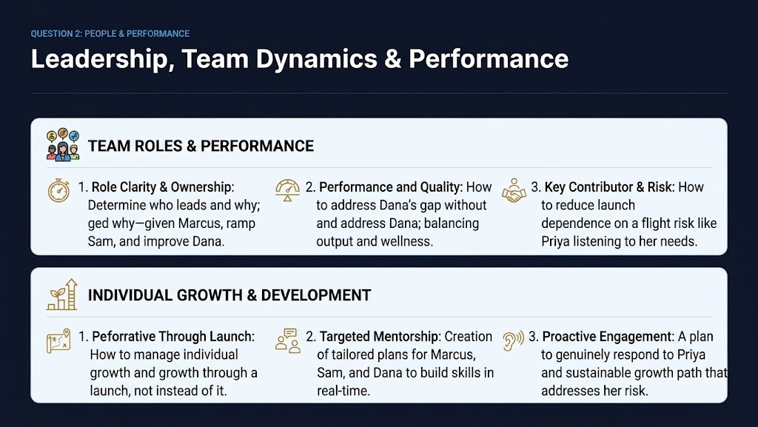

Slide 8
QUESTION 2: PEOPLE & PERFORMANCE
Team Deployment: Growth-Oriented Assignments
Priya (Senior)
Marcus (Mid)
Dana (Mid)
Sam (Associate)
RETENTION & LEADERSHIP
STRETCH TO SENIOR
QUALITY GAP CLOSURE
RAPID RAMPING
•
Role: Leads SSO Identity Handoff & cross-squad architecture.Given broad team leadership responsibilities, supported by EM.
•
Role: Project Coordinator & Degraded-Mode Fallback Lead.
•
Role: Co-owns resilience testing & telemetry instrumentation.
•
Role: Tenant-Isolation Guardrail Lead (paired with EM).
•
Growth: Owns Supply integration seam & project plan tracking.
•
Growth: Paired with Marcus; enforces 85% Vitest coverage gates.
•
Growth: Focuses on database query scoping & baseline logic.
•
Growth: Expands scope toward Staff IC; mentors Sam.
•
Impact: Leverages technical project management strengths.
•
Impact: Closes quality gap without dampening morale.
•
Impact: Accelerates core skills via weekly 1:1 mentorship.
•
Mitigation: Prevents single-threading by documenting auth patterns.

Slide 9
QUESTION 2: OWNERSHIP & GOVERNANCE
Project Governance & Hierarchical RACI Structure
Governance Hierarchy & Delegation Flow
Engineering Manager / Player-Coach (Me)
ACCOUNTABLE (A) — Ultimate Accountable Owner for Project Success
Priya — Tech Lead / TPM (Under EM)
ACCOUNTABLE & RESPONSIBLE (A/R) — Tech Architecture, Cross-Squad Contracts & Leadership
Priya (Senior)
Marcus (Mid)
Dana (Mid)
Sam (Associate)
SSO & Auth Handoff
Project Coordinator
Quality & Test Owner
Tenant Isolation
Responsible (R)
Plan Tracking & Fallbacks
SIT, Telemetry & Alerts
Paired with EM
Role / Member | Governance Title | Component & Task Ownership | RACI Status
EM (Me) | Overall Project Owner | Tenant Isolation Architecture & Delivery Sign-off
Priya | Tech Lead / TPM | SSO Identity Handoff & AWS Secrets/Infra Scaffold
Marcus | Project Coordinator | Project Plan Tracking, Supply API Integration & Degraded Fallbacks
Dana | Quality & Test Lead | Load/Stress Testing, APM Telemetry & Rootly Alert Workflows
Sam | Associate Developer | Tenant-Isolation Guardrail (Database Query Scoping)
Accountable (A)
Accountable / Resp.
Responsible (R)
Responsible (R)
Responsible (R)

Slide 10
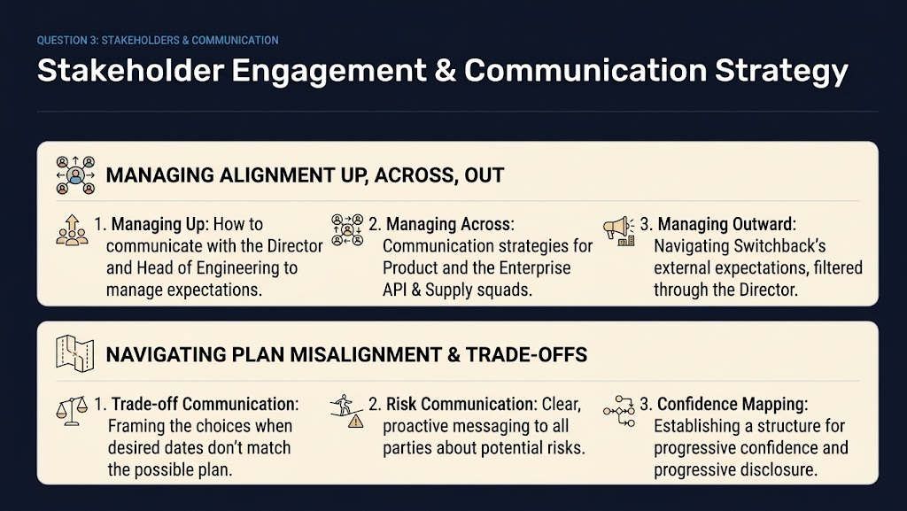

Slide 11
QUESTION 3: STAKEHOLDERS & COMMUNICATION
Stakeholder Alignment & Tradeoff Management
Managing Up (Director / Head)
Managing Across (Product & Squads)
Managing Outward (Switchback)
•
Twice-weekly Status: Transparent milestone tracking backed by R/Y/G confidence indicators.
•
Product Alignment: Weekly scope reviews to protect project objectives and ensure product alignment.
•
Director Channel: Filter external comms through Director and me to maintain unified messaging. Regular cadence with Switchback on progress, schedule slippage, and change management
•
Early Risk Escalation: Raise external dependency blockers immediately with proposed solutions.
•
Interface Contracts: Lock OpenAPI schemas & Fastify route validators early with external leads.
•
Tradeoff Menus: Present choices (e.g., defer non-critical features vs. extend canary ramp).
•
Cross-Squad Syncs: Bi-weekly technical touchpoints with Enterprise API & Supply squad managers.
•
Honest Rollout Dates: Frame timelines around progressive canary metrics rather than hard dates.
•
Partner Expectations: Transparent progress updates on 1% → 100% traffic migration.
•
Trade-offs: Keep a list of potential downgrades to offer up as trade-offs to ensure quality and on-time delivery, including: reduced team member growth capacity for Marcus, fewer canary gates in sprint 4, and trading off 20% on-going capacity prior to project for more dedicated project-time

Slide 12
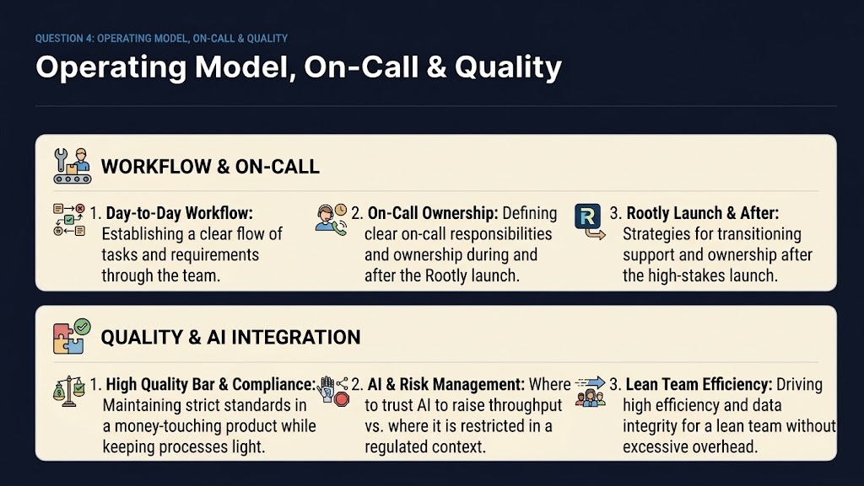

Slide 13
QUESTION 4: OPERATING MODEL & QUALITY
Day-to-Day Cadence, On-Call & AI Governance
Day-to-Day Workflow
On-Call & Rootly Orchestration
AI Throughput vs. Guardrails
•
2-Week Sprints: Agile cadence with daily standups, backlog grooming, and blameless retrospectives.
•
Primary/Secondary Rotation: Weekly on-call shift during core hours (9 AM – 7 PM EST).
•
Permitted AI Use: Test suite scaffolding, schema drafting, documentation/READMEs, and boilerplate code.
•
Quality Gates: Mandatory CI/CD checks enforcing 85% Vitest unit test coverage before PR merge.
•
New Relic NRQL Triggers: Automated alert webhooks to Rootly for error spikes or latency breaches.
•
Strictly Prohibited AI: Core tenant isolation rules, DB query boundary logic, auth handoffs, and money-touching code.
•
Peer Code Reviews: All PRs require 1 senior sign-off and automated SAST security scans. Regular synchronous code reviews and asynchronous. Synchronous reviews allow the team to meet, comment on code and testing together, learn and share.
•
Support Triage: Switchback support acts as Tier 1; automated playbooks guide Tier 2 escalations.
•
Human Supervision: Active prompt intervention (`[Esc]`) to prevent unguided security shortcuts.
Human in the loop means: all and any code is human owned-- a human’s name is attached to all code, making accountability an enforcer for quality. Quality and governance are baked into our operating plan.

Slide 14
QUESTION 4: TECHNICAL QUALITY BAR
Load-Bearing Guardrail: Structural Tenant Isolation
Structural Query Scoping (`OfferRepository`)
Verification & Security Principles
Database-level tenancy constraint prevents cross-tenant data leaks at the query builder boundary:
•
Zero Runtime Assumptions: Tenancy is enforced at the DB query level, not filtered in application memory.
async findOffersByTenant(context: TenantContext) {
const tenantId = context?.tenantId;
if (!tenantId) throw new Error('Invalid context');
// Bound query strictly to tenant_id
let query = this.db('offers').where('tenant_id', tenantId);
// Exclude exclusive rates for tenant0
if (tenantId === 'tenant0') {
query = query.andWhere('is_exclusive', false);
}
return await query.select();
}
•
Strict Verification: `SwitchbackIdentityHandoff` verifies RS256 token signature & extracts verified `tenantId`.
•
Double Defense: `OfferService.getValidOffers()` validates expiration and redemption limits after scoped fetching.
•
Compliance Guardrail: Guarantees money-touching offer exclusions are mathematically isolated per tenant.

Slide 15
EXECUTIVE SUMMARY
Ready to Execute: Low Risk, High Integrity Delivery
Delivery Confidence
Quality & Governance
1,024 net available feature hours backed by a 20% carryover buffer guarantees on-time Sprint 4 rollout.
Database-bound tenant isolation, progressive 1%–100% canary ramp, and Rootly on-call workflows ensure high uptime.
Questions & Discussion

